Slide 1
Association Rule Mining

Slide 2
Alternative Methods for Frequent Itemset Generation
Traversal of Itemset Lattice
General-to-Specific vs Specific-to-Geneal
Equivalence Classes
Breadth-first vs. Depth-first
Representation of Transaction Data
Horizontal vs. Vertical data layout

Slide 3
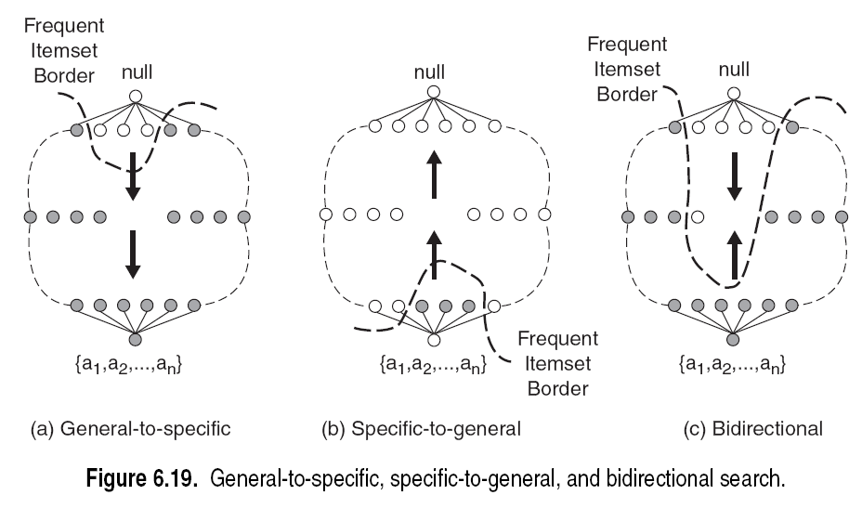

Slide 5
Breadth-first vs. Depth-first

Slide 6
Breadth-first vs. Depth-first

Slide 7
Breadth-first vs. Depth-first
For finding maximal frequent itemsets, which approach you would take?
BFS
DFS
⬅

Slide 8
Breadth-first vs. Depth-first
Quick FI border detection!
Once a maximal FI is found, substantial pruning can be performed on its subsets
bcde is MFI, then we need not visit the subtrees rooted at bd, be, c,d, & e because they will not contain any MFI
If abc is MFI, then only the nodes such as ac & bc are not MFI.
If support for abc is identical to ab, then abd & abe can be skipped because they will not have any MFI

Slide 9
Alternative Methods for Frequent Itemset Generation
Representation of Database
horizontal vs vertical data layout

Slide 10
Variations of the Apriori
Many variations of the Apriori has been proposed that focus on improving the efficiency of the original algorithm
Hash-based technique- hashing itemset counts
Transaction reduction-reducing the number of transactions scanned in future iterations
Partitioning-partitioning the data to find candidate itemsets
Sampling-mining on a subset of the given data
Dynamic itemset counting-adding candidate itemsets at different points during a scan

Slide 11
FP-growth Algorithm
Use a compressed representation of the database using an FP-tree
Once an FP-tree has been constructed, it uses a recursive divide-and-conquer approach to mine the frequent itemsets

Slide 12
FP Growth Algorithm
NO candidate Generation
A divide-and-conquer methodology: decompose mining tasks into smaller ones
Requires 2 scans of the Transaction DB
2 Phase algorithm
Phase I
Construct FP tree (Requires 2 TDB scans)
Phase II
Uses FP tree (TDB is not used)
FP tree contains all information about FIs

Slide 13
FP-tree construction
null
After reading TID=1:
A:1
B:1
After reading TID=2:
null
A:1
B:1
B:1
C:1
D:1

Slide 14
FP-Tree Construction
Transaction Database
null
A:8
B:2
B:5
C:2
C:1
D:1
Header table
D:1
C:3
E:1
D:1
E:1
D:1
E:1
D:1
Pointers are used to assist frequent itemset generation

Slide 15
FP-growth
Conditional Pattern base for D: P = {(A:1,B:1,C:1), (A:1,B:1), (A:1,C:1), (A:1), (B:1,C:1)}
Recursively apply FP-growth on P
Frequent Itemsets found (with sup > 1): AD, BD, CD, ACD, BCD
null
A:8
B:2
B:5
C:2
C:1
D:1
C:3
D:1
D:1
D:1
D:1

Slide 16
Steps in FP-Growth Algorithm
Given: Transaction DB
Step 1: Support_count for each item
Step 2: Header Table (ignore non-frequent items)
Step 3: Reduced DB (ordered FIs for each tx.)
Step 4: Build FP-tree
Step 5: Construct conditional pattern base for each node in FP tree (enumerate all paths leading to that node). Each item will have a conditional pattern base which may contain many paths
Step 6: Construct conditional FP-tree

Slide 17
Construct FP-tree from a Transaction DB: Steps 1-4
TID Items bought (ordered) frequent items
100 {f, a, c, d, g, i, m, p} {f, c, a, m, p}
200 {a, b, c, f, l, m, o} {f, c, a, b, m}
300 {b, f, h, j, o} {f, b}
400 {b, c, k, s, p} {c, b, p}
500 {a, f, c, e, l, p, m, n} {f, c, a, m, p}
{}
Steps:
Scan DB once, find frequent 1-itemset (single item pattern)
Order frequent items in frequency descending order
Scan DB again, construct FP-tree
Header Table L
Item frequency node-links
f 4
c 4
a 3
b 3
m 3
p 3
f:4
c:1
c:3
b:1
b:1
a:3
p:1
m:2
b:1
p:2
m:1

Slide 18
Points to Note
4 branches in the tree
Each branch corresponds to a Tx. in the reduce Tx. DB
f:4 indicates that f appears in 4 txs. Note that 4 is also the support count of f
Total occurrences of an item in the tree = support count
To facilitate tree traversal, an item-header table is built so that each item points to its occurrences in the tree via a chain of node-links
Problem of mining of FPs in TDB is transformed to that of mining the FP-tree

Slide 19
Mining FP-tree
Start with the last item in L (p in this example)
Why?
p occurs in 2 branches of the tree (found by following its chain node links from the header table)
Paths formed by these branches are:
f c a m p:2
c b p:1
Considering p as suffix, the prefix paths of p are:
f c a m: 2
c b: 1
Sub database that contains p
Conditional FP tree for p {(c:3)}|p
Frequent Patterns involving p: {cp:3}

Slide 20
Step 5: From FP-tree to Conditional Pattern Base
Starting at the frequent header table in the FP-tree
Traverse the FP-tree by following the link of each frequent item
Accumulate all of transformed prefix paths of that item to form a conditional pattern base
Header Table
Item frequency head
f 4
c 4
a 3
b 3
m 3
p 3
{}
Conditional pattern bases
item cond. pattern base
c f:3
a fc:3
b fca:1, f:1, c:1
m fca:2, fcab:1
p fcam:2, cb:1
f:4
c:1
c:3
b:1
b:1
a:3
p:1
m:2
b:1
p:2
m:1

Slide 21
Step 6: Construct Conditional FP-tree
For each pattern-base
Accumulate the count for each item in the base
Construct the FP-tree for the frequent items of the pattern base
{}
m-conditional pattern base:
fca:2, fcab:1
Header Table
Item frequency head
f 4
c 4
a 3
b 3
m 3
p 3
f:4
c:1
{}
All frequent patterns concerning m
m,
fm, cm, am,
fcm, fam, cam,
fcam
c:3
b:1
b:1

a:3
p:1
f:3

m:2
b:1
c:3
p:2
m:1
a:3
m-conditional FP-tree

Slide 22
Mining Frequent Patterns by Creating Conditional Pattern-Bases
Item
Conditional pattern-base
Conditional FP-tree
p
{(fcam:2), (cb:1)}
{(c:3)}|p
m
{(fca:2), (fcab:1)}
{(f:3, c:3, a:3)}|m
b
{(fca:1), (f:1), (c:1)}
Empty
a
{(fc:3)}
{(f:3, c:3)}|a
c
{(f:3)}
{(f:3)}|c
f
Empty
Empty

Slide 23
Single FP-tree Path Generation
Suppose an FP-tree T has a single path P
The complete set of frequent pattern of T can be generated by enumeration of all the combinations of the sub-paths of P
{}
All frequent patterns concerning m
m,
fm, cm, am,
fcm, fam, cam,
fcam
f:3

c:3
a:3
m-conditional FP-tree

Slide 24
Principles of Frequent Pattern Growth
Pattern growth property
Let α be a frequent itemset in DB, B be α's conditional pattern base, and β be an itemset in B. Then α ∪ β is a frequent itemset in DB iff β is frequent in B.
“abcdef ” is a frequent pattern, if and only if
“abcde ” is a frequent pattern, and
“f ” is frequent in the set of transactions containing “abcde ”

Slide 25
Why Is FP-Growth Fast?
Performance study shows
FP-growth is an order of magnitude faster than Apriori
Reasoning
No candidate generation, no candidate test
Uses compact data structure
Eliminate repeated database scan
Basic operation is counting and FP-tree building

